Slide 1

National Science Foundation Division of Undergraduate Education Grant Writing Workshop
Pamela Brown, NSF Program Director
Division of Undergraduate Education (DUE)
195th 2YC3 Western Conference
MiraCosta College, Oceanside, CA
March 31, 2012

Slide 2
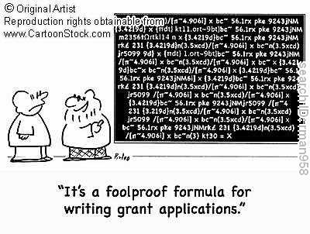
While there is no magic formula for writing funded proposals, there are strategies to improve your chances

Slide 3
Writing a good proposal requires time and commitment
Start EARLY. Research the literature. Assemble the project team. Work together to create a shared vision. Decide on responsibilities and a timeline. Obtain evidence of support. Develop the budget based on needs.
Read the Program Solicitation and follow the guidelines. Read the Grant Proposal Guide (GPG).
  Learn about the recent DUE awards using the NSF Award Search tool. Ask PIs for a copy of a similar funded proposal
  Contact (e-mail is best) a program officer to discuss your idea. This may cause you to refine your idea and may prevent you from applying to the wrong program
  Program Officers in DUE: Check the solicitations for names and contact information. Outreach is part of our job!
  Get acquainted with FASTLANE
  Become an NSF reviewer

Slide 4

Understanding the review process may help you write more successful proposals
Topics to be covered include:
Review Criteria.
Description of how review panels are formed
Summary of instructions to reviewers
Today’s activity:
Individuals read the proposal and then teams discuss strengths and weaknesses and write a panel summary
Teams report/discuss results

Slide 5
All proposals are evaluated using the National Science Board approved review criteria
  Intellectual merit (IM)
  Broader impacts (BI)
Some solicitations have additional criteria
Criteria are NOT:
  A complete list of “requirements”
  Applicable to every proposal
  An official checklist

Slide 6
IM - Requirement for all Proposals
Must be addressed in the project summary
Intellectual Merit
How important is the proposed activity to advancing knowledge and understanding within its own field or across different fields?
How well qualified is the proposer (individual or team) to conduct the project? (If appropriate, the reviewer will comment on the quality of the prior work.)
To what extent does the proposed activity suggest and explore creative, original, or potentially transformative concepts?
How well conceived and organized is the proposed activity? Is there sufficient access to resources?

Slide 7
BI - Requirement for all Proposals
Must be addressed in project summary
Broader Impact
How well does the activity advance discovery and understanding while promoting teaching, training, and learning?
How well does the proposed activity broaden the participation of underrepresented groups (e.g., gender, ethnicity, disability, geographic, etc.)?
To what extent will it enhance the infrastructure for research and education, such as facilities, instrumentation, networks, and partnerships?
Will the results be disseminated broadly to enhance scientific and technological understanding?
What may be the benefits of the proposed activity to society?
Examples illustrating activities likely to demonstrate broader impacts are available electronically on the NSF website

Slide 8
Reviewing for the NSF
Proposals from similar institutions and from similar disciplines are grouped together
Reviewers are solicited by program directors. You can volunteer to review for a program; you will need to submit a CV. ~5-6 reviewers/panel
Reviewers receive ~12 proposals electronically 2 to 3 weeks before the panel.
Reviewers electronically prepare reviews before the review panel meets.

Slide 9
Reviewers rate proposals from Fair to Excellent and prepare comments on strengths and weaknesses/concerns
Excellent (5)/ Very Good (4)/ Good (3)/ Fair (2)/ Poor (1)
Reviewer comments should align with the rating
Ratings may be changed after the panel discussion
Usually a rating of higher than 3.5 makes the proposal competitive
Program directors make funding recommendations

Slide 10
Reviewer written comments include intellectual merit, broader impacts and a summary statement
Intellectual merit (IM)
  General summary of project (2-3 sentences)
  Describe strengths
  Describe weaknesses/concerns
Broader impacts (BI)
  Describe strengths
  Describe weaknesses/concerns
Summary statement .
  Overall strengths
  Overall concerns
  A rationale that justifies your rating

Slide 11
Reviewers meet to discuss the proposal and write a panel summary
Held Over Two Days in Washington DC
Panel Chair (picked by program director ahead of time) establishes order of proposal review process
Proposals are discussed individually
A “scribe” is designated to capture all of the points brought up in discussion and produce a summary review – called the “Panel Summary”
The reviews and panel summaries are written to provide guidance for declines and negotiating points for awards

Slide 12
Reviews and panel summaries are written for both applicants and NSF program directors
NSF program directors
  Informs recommendations relative to funding
  Guides pre-award negotiations
Applicants
  If proposal is funded:
    Provides suggestions for improving project
  If proposal is not funded:
    Provides information to guide a revision of the proposal. Don’t just rely on the reviews. Work on improving the project.

Slide 13
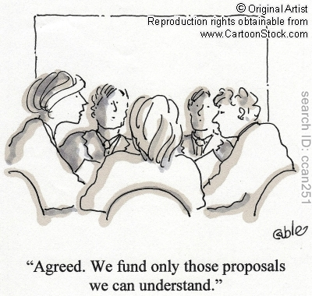
Mock Panel Review
Understanding the review process may help you to prepare better proposals.

Slide 14
Thank you for your participation
  For more information:
DUE Web Site - http://www.nsf.gov/div/index.jsp?div=DUE
Vet ideas with a program officer
Volunteer to review proposals.
  Opinions expressed in this presentation are those of the presenter and are not official NSF policy
Notes:
14

